Slide 1
African School of Fundamental Physics: Preparing African Students for World Science
Scientific Session #21890, Science in Africa: New Programs and Contributions
Christine Darve, Ph.D.
on behalf of the ASP International Organizing Committee
https://www.africanschoolofphysics.org/
Notes:
A project reflecting initiative from world wide scientists to transcend geographical boundaries and share our knowledge with African students

Slide 2
Outline
Mission of the African School of Fundamental Physics and Applications
ASP Organization
Expanding our Program
More High-Stories Transcending Boundaries
Notes:
Expanding in Space, Time and Goals

Slide 3
ASP as a start-up
A non-profit organization created by a small group of worldwide scientists to stimulate and include more African talented physics students in the world scientific community
The aim of the school is to build capacity in African countries, to harvest, interpret, and exploit the results from physics experiments with particle accelerators, and to increase proficiency in related applications and technologies.
To contribute to a world w/ equal access to knowledge
To support financially up to 85 African students for 3-week classes attendance
To establish a biennial educative program to be hosted across Africa
To provide high quality classes by international re-known Scientists
Notes:
Based on the experience of few European and American scientists, we have created a network, an organization, to stimulate and include more African talented physics students in the world scientific community.
Our mission is to help increase the number of African students acquiring higher education.
We have felt that American and European big science programs, have a lot to share in order to improve the world condition, hence science transcending boundaries…
“Everything “ pass by knowledge, and education is the pillar of well-being, and a peaceful world. Our goal was also to contribute to limiting the brain drain, by increasing capacity within African universities and promote spin-off for large scale activities IN Africa (see SKA, Af LS)
---
This is achieved through an outreach effort, an increased awareness of the potential of high quality training offered by large scale experiments in context in various scientic disciplines, and a system of networking on the international scale.
There is a strong alignment between the mission and the vision of African governments and policy makers on education and capacity building and their programs with the goals of the ASP.

Slide 4
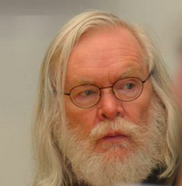
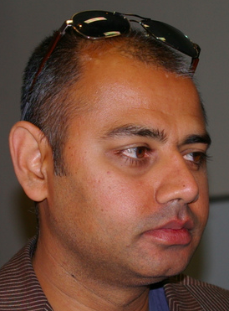
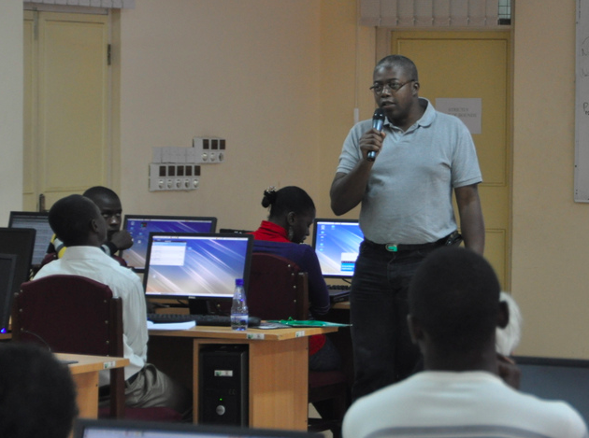
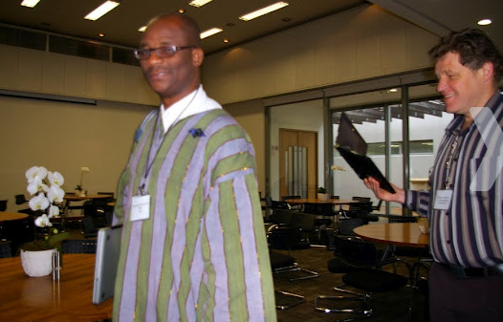
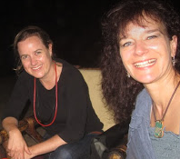
Committees to build momentum
Build strategic partnership and collect financial support from Africa, Europe, US, Asia via universities, laboratories, UN, and other organizations.
Use the LHC and its experiments as an example, although the broader objectives are far beyond.
We believe that the knowledge that the students gain will benefit them whichever careers they may pursue.
Conceptual thinking by Steve Muanza and John Ellis in 2001 and IN2P3 to trigger.
International Center for Theoretical Physics (ICTP), Bobby Acharya, as incubator and greatly encouraged by CERN and Fermilab.
Preparation teams leaded by Ketevi Assamagan and Christine Darve (ASP2010).
Notes:
What are the magic ingredients beyond ideals definition??
The right People + Financial supports, and dedication in order to build-up an organization that “worth fighting for..”
From the concept in 2001, to the realization of the first school in 2010, the road has been long, and filled with challenges (for scientists that we are…). This became possible with the financial and logistics support of CNRS, ICTP, CERN and Fermilab (or US HEP laboratories?).

Slide 5
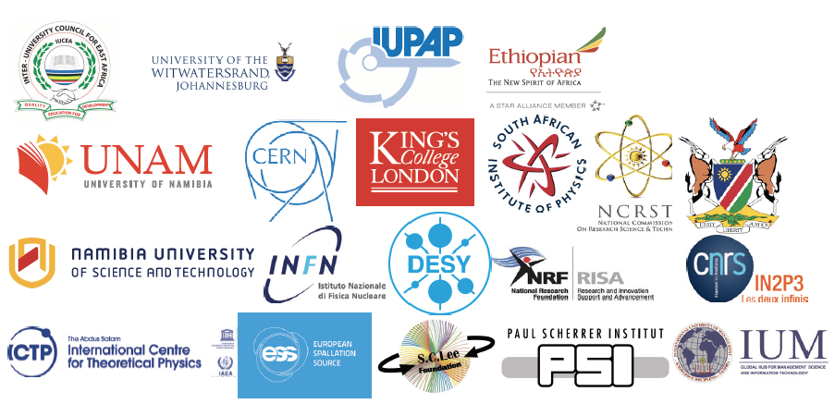
Sponsorship & financial support
ASP2018 Sponsors in addition to USA DOE Labs (BNL)
African Contributors:
- Namibia
- SA DST/NRF
- IUCEA
Integrated: ~50% of ASP2018 budget
ICTP Support major
Student participation
Management of application database
Arrange student travels
Fund Management
Funds centralized and managed by the South African Institute of Physics (SAIP)
Host Country Support Significant
In-kind support
Direct Financial contributions
Human Resources toward ASP Organization
Writes Proposals, Requests for Supports
Produces Final Reports of Activities
Seeking permanent financial backing
IOC
Lecturers and Organizers Supported by External Sources - Significant
Support received then used to maximize student participation
Notes:
Unfortunately, in our conjuncture, Nothing can be done without financial support..
The approximate budget is 160 kE per edition, shared between 15-20 different institutes, embassies and foundation across the world.
Beyond its financial support, ICTP support the logistics necessary for events preparation (CERN too).
Host country shall guarantee significant In-Kind support e.g. accommodation, catering.
Lecturers are paying for their fee.
The example of the ASP2018 sponsors are shown. Sponsors will vary largely between editions.
The supporting institutes since the first edition are ICTP and CERN, BNL, Fermilab, J-Lab, IUPAP, PSI then joined INFN, DESY, EPS, the Shui-Chin Lee foundation for basic science , Theorem Holdings Corporation, Metatron Global SA;
African contribution represents about 50 % of the income, with a continuous support from SA NRF and DST
The IOC is coordinating the whole process by writing proposal for fund raising, deciding on the whole program.

Slide 6
ASP Organization
Local Organizing Committee (LOC)
in the host country
Local logistics
Liaise with Education and Research branches of host country government
Strong interplay between the IOC, LOC and IAC Committees
International Organizing Committee (IOC)
Overall management
Fund raising
Coordination of activities
International Advisory Committee (IAC)
Representatives of funding agencies
Advise on the program
Advise of the host country selection
Assessment of Impact
Survey of students
Survey of their Professors
Follow academic developments
Spin-Offs
ASP Mentorship/Coaching Program
Networking and sharing of information
Align ASP with educational priorities
Improve future editions of ASP
Promote research collaborations
Promote research consortia
International Lecturers panel (IL)
Design the scientific Program
Help with the student selections
Mentor and Coach students continuously
Notes:
How are we organized ?
The core of the organization is the IOC, responsible for the fund raising, the students selection (with help of the IL panel), etc..
LOC support for infrastructure and local logistics, Computing hands-on: Monte Carlo, ROOT, GEANT4 exercises, etc..
IAC, composed of the funding agency representation
The different lecturers are gathered in a panel and help defining the scientific program and selecting the students and following-up with them.
Before, during and after the events, the different committees and panels work together to track and improve the growing activities of the ASP.
Spin-off are important for our mission.
We want to promote the academic capacity in Africa and follow-up with our alumni students. A program mentor-mentee was created.
Also, we encourage the creation of innovative projects in Africa, like e.g. the Af LS.

Slide 7
The topics of interest
Theoretical Physics Experimental Physics Accelerator and Applications
and GRID
Nuclear and Particle Physics
Beyond the Standard Model
Astro‐particle physics and Cosmology
Theoretical Heavy‐ion physics
Linux tutorials
Particle Detectors
Particle Identification and Data Analysis and statistics
Exp. Particle physics, current status of the field
Exp. Nuclear Physics
Exp. Heavy Ion Physics
Exp. Astro‐particle Physics
Accelerator physics and Technology
Physics of Particle Beams
Instrumentation
Medical Applications
Neutron and Light Sources
Energetics and solid state
GRID and computing
Digital Library
Example of ASP timetable:
ASP2018: https://indico.cern.ch/event/656460/timetable/?view=standard
Notes:
Which topics are we covering ?
Beyond our core topics of interested, based on our own background (th. Exp. App), we have continuously adapted the program, to reflect the African students level and preferences. E.g we have added more computing hands-on Linux Boot Camp).
- Th: describe the standard Model and quantum field theory.
- Exp: deals with detectors , data analysis and statistical treatment to give participants an introduction to how raw data is transformed into final measurements
- Appl: . The scientific disciplines are thr basics of particle accelerator technology, applied physics , medical physics and material science.
- The two-day sessions are dedicated to GRID computing session supported by the DOSAR Distributed Organization for Scientic and Academic Research (DOSAR) and the Open Science Grid (OS-Grid).
Medical applications , nuclear physics and astrophysics are systematically topics of interest in Africa.
We systematically include local lecturers to cover their topics.
Depending on the host country, different categories can be enhanced.
Timetable of African School of Fundamental Physics and Applications:
ASP2010: https://indico.cern.ch/event/78565/timetable/?view=standard
ASP2012: https://indico.cern.ch/event/145296/timetable/?view=standard
ASP2014: https://indico.cern.ch/event/276481/timetable/?view=standard
ASP2016: https://indico.cern.ch/event/528094/timetable/?view=standard
ASP2018: https://indico.cern.ch/event/656460/timetable/?view=standard

Slide 8
ASP Program Expansion
High School Teachers Program
1-week intensive workshop
Train High School Teachers for improved physics teaching
Student Program
3-week intensive school
3rd year of University to Ph.D.
Mostly African Students
70-80 Students; total > 320
ASP Conference
1-week International Conference
Participation of ASP Alumni
Part. Research Faculties
Networking & collaborations
Forum and Outreach
2 events
Involve Regional policy makers
Promote spin-off activities in Africa
Introduce students to policy
Learners Program
1-week learners Outreach
10-12th grade learners
Encourage learners to develop and maintain interests in Physics and Applications
Mentorship/ Coaching Program
Work with Academic Advisors
Connect Students w/ Researchers
Place students at Labs
Support students & help address their academic needs
Notes:
Since 2010, the core of the program, includes the academic lectures and exercises for the students and the Forum and outreach activities to involve the regional policy makers.
To improve the events, we have added more discussion sessions with the students (in French and English) so that they can digest the lecture content.
Since 2016, we have expanded our program by preparing in parallel to the students courses, a workshop for high-school teachers.
In order to further foster the interest of physics in the African world, we have added visits and teaching to local high-schools.
The introduction of a Conference to include more scientists, and encourage networking among alumni students and professionals.
Finally, the expansion includes, as well, a well-defined process for coaching Alumnin students.

Slide 9
Overview
ASP2018
5th Edition in Namibia
June 24 to July 14, 2018
85/523 students from 26 countries
Student presentations
Expansion
- Pupils Outreach (30 sch., 1500 learners, 1 wk)
- Teachers Workshop (63 teachers, 1 week)
- Professional Physics Conference (1 week)
ASP2010
1st Edition in South Africa
August 1-21, 2010
65 selected students from 17 countries (125 applications)
ASP2020 Morocco
Host countries selected
2.5 years earlier
through a bidding process
ASP2016
4th Edition in Rwanda
August 1-19, 2016
80/429 students from 28 countries
Expansion:
-Pupils Outreach (3 schools, 150 pupils, 3 days)
-Teachers Workshop (20, 2 days)
ASP2012
2nd Edition in Ghana
July 15 to August 8, 2012
50/138 students from 15 countries
ASP2014
3rd Edition in Senegal
August 3-23, 2014
70/330 students from 21 countries
Notes:
We identified the first location for the ASP2010 in SA , because of its fruitful connection with CERN (ALICE, ATLAS) and its higher education capacity.
Plus, in SA, stands the Main Particle Accelerator in Africa, namely I-THEMBA LABS, which will be presented in the next talk by Rudzani Nemutudi.
The 2010 school preparation, served as a base/model for the following schools editions.
The overall and simplified view of the events are listed here, and more information is available on our web site.

Slide 10
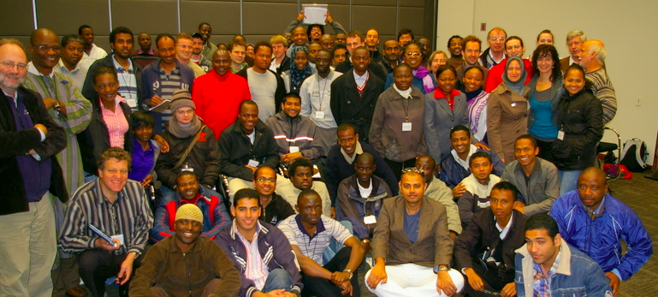
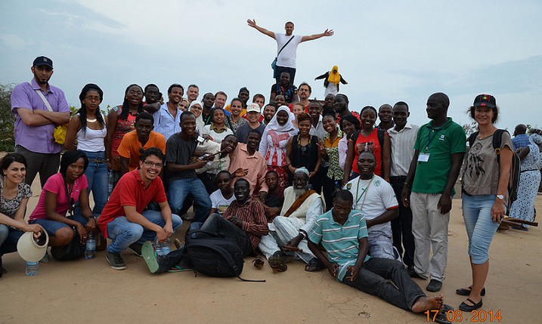
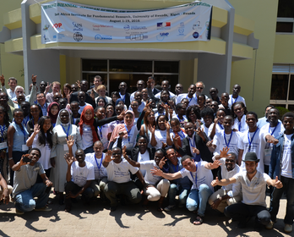
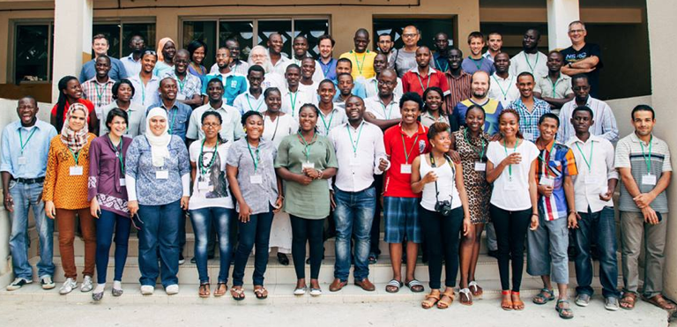
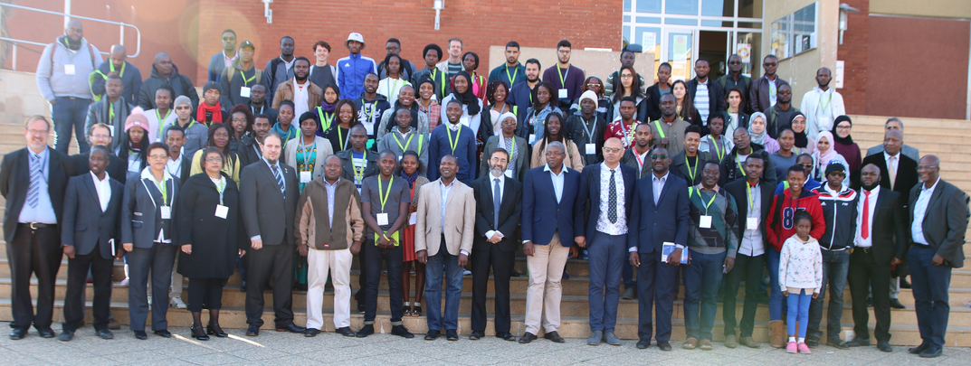
ASP Students
Notes:
More than 320 students from most African countries, with presence of European , American and Asian students to create the perfect melting pot of culture, knowledge and diversities, fusing into a perfect scientific integrity

Slide 11
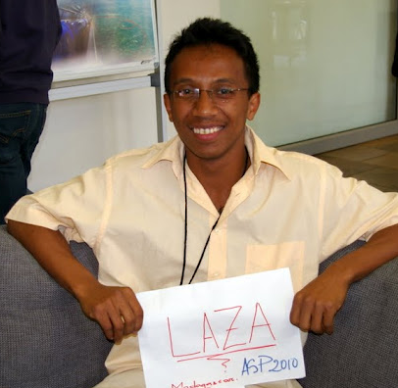
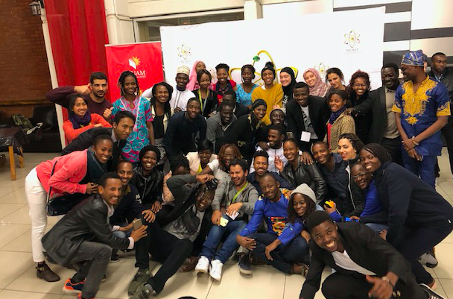
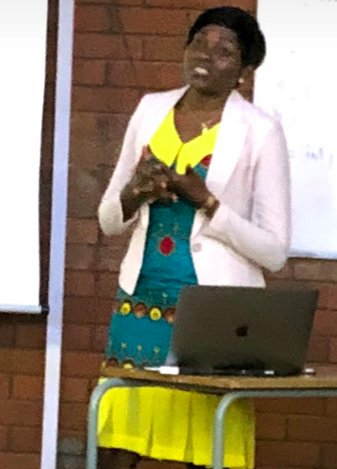
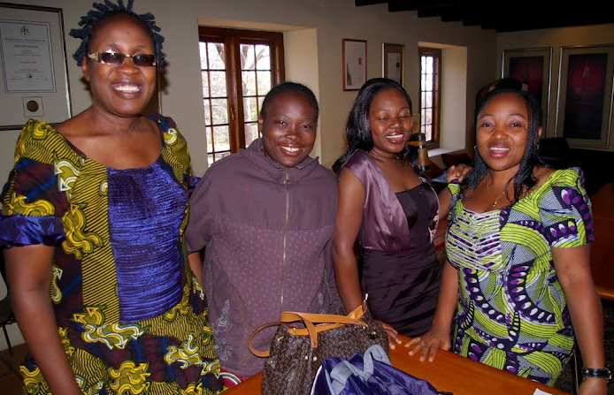
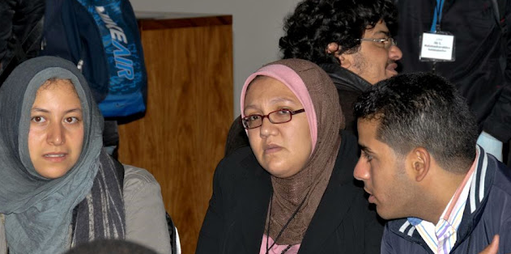
ASP Students
Provide partial or full financial support to students and create a scientific melting pot of cultural diversity
Diversity of academic levels
Mainly Master and PhD students
Diversity of education background
From theoretical physics to engineering sciences
Diversity of the countries of origin
Priority to Sub-Saharan African students
Women participation (~32%)
Role of women in LDC.
Local Universities
Involve students and professors

Slide 12
ASP2018 Students Profile
Notes:
We select local students based their academical results.
A representation of the major African countries are well represented in our schools.
Different categories representation for each edition depending the the strength/interest of the host country.
The age and levels may vary depending on the editions, e.g. in 2018, we tune the program and encourage younger students to pursue their career in physics.

Slide 13
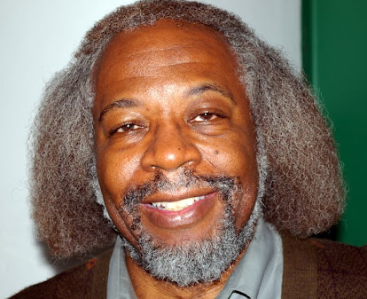
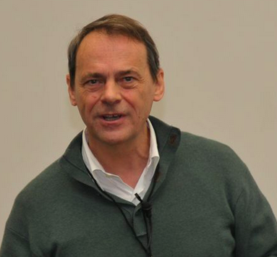
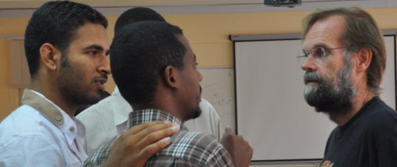
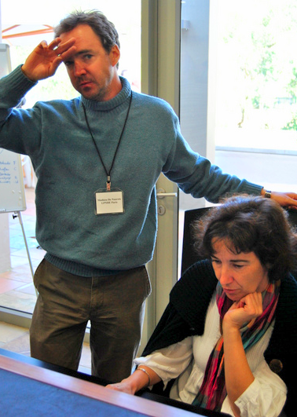
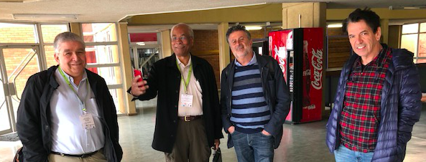
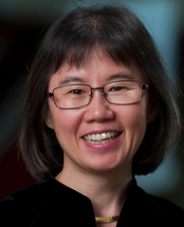
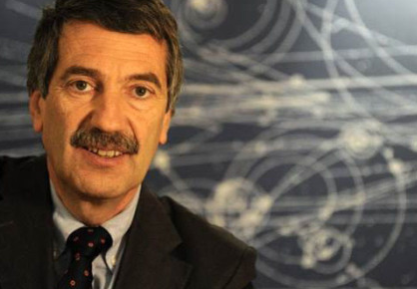
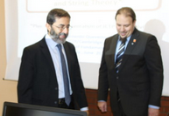
World-Class Lecturers
People-oriented lecturers willing to share their experience with African students
Highly motivated and motivating characters
Most of ASP lecturers are financially supported by their home institutes
Provide fruitful interactions with students
Lecturers typically attend the ASP for 3 - 7 days
Notes:
World class professors & Leaders !!
Among many:
Prof Jim Gates Enlighted our students with String theory, and is considered as a Ambassador for Science for most of them.
Prof. Young-Kee Kim involvement and support for a FNAL fellowship in 2010. Laza has now graduated with his PhD and is back in Madagascar for serving as the spoke person in Dune.
Prof. Fernando Quevado met in 2009, permitted ICTP to sponsor the ASP as a start-up.
Prof. Fernando Ferroni is now a strong supporter of the ASP and permitted INFN to contribute financially.

Slide 14
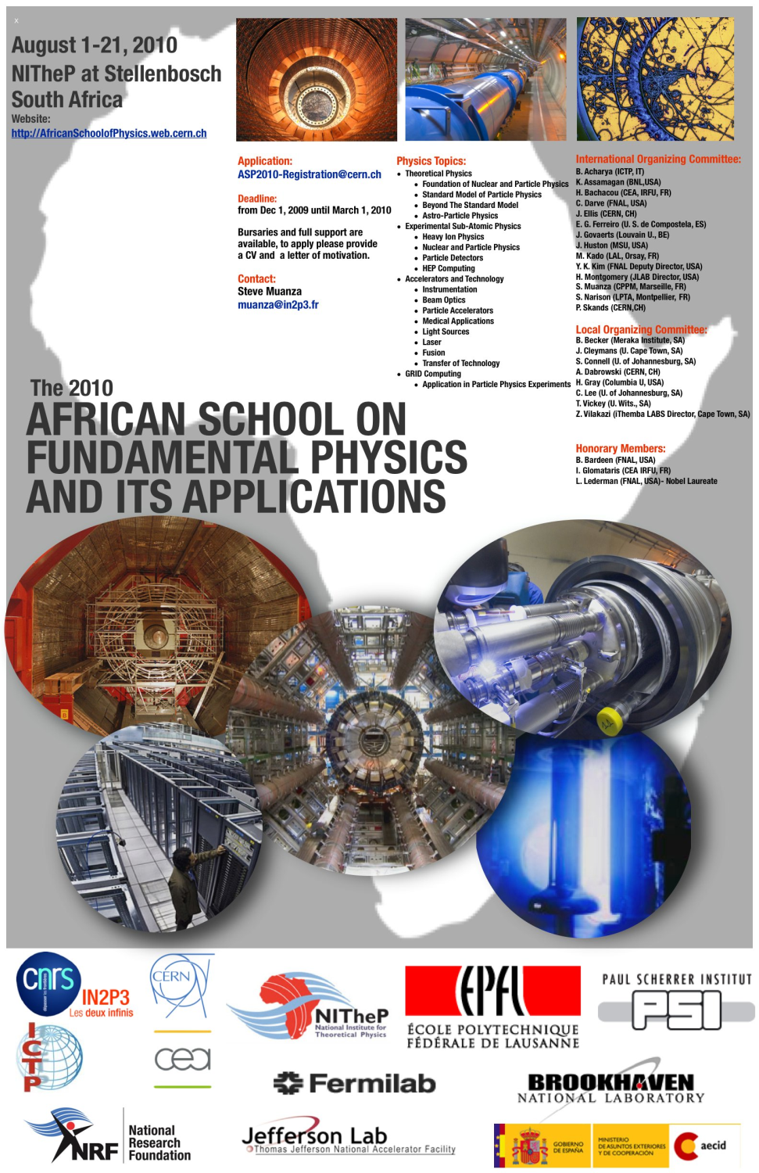
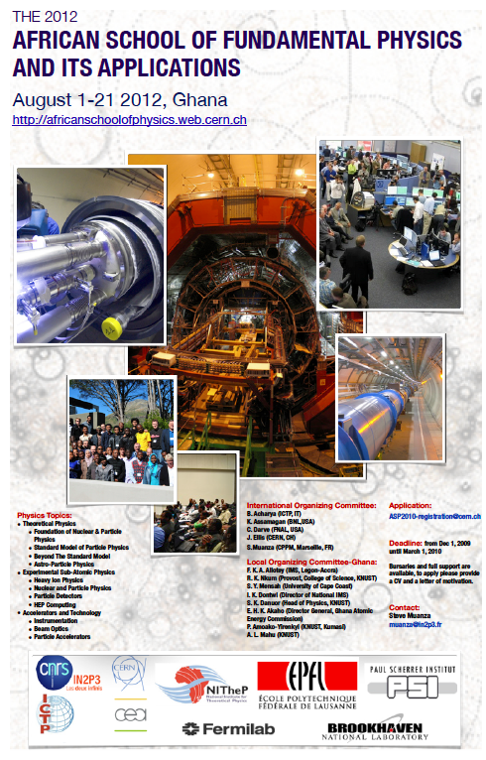
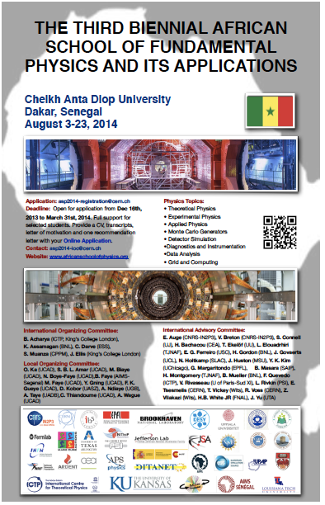
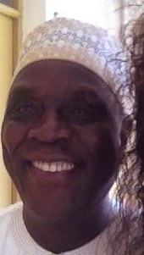
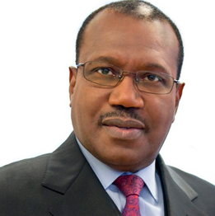
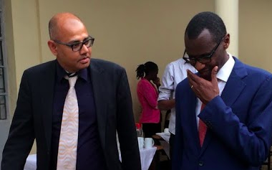
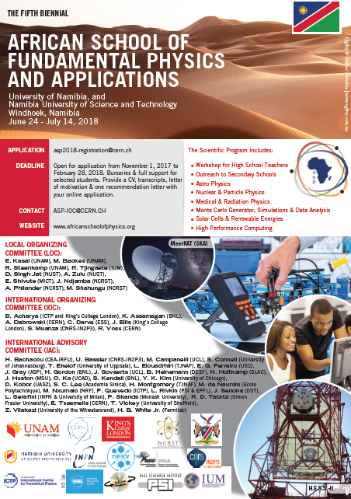
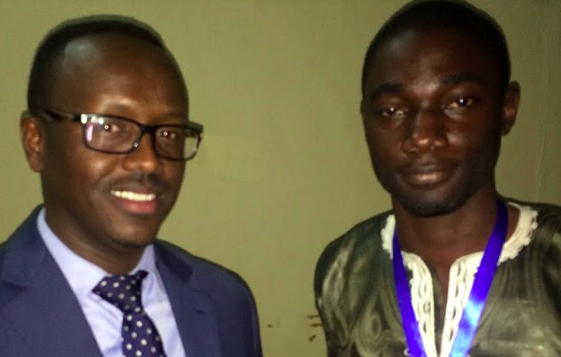
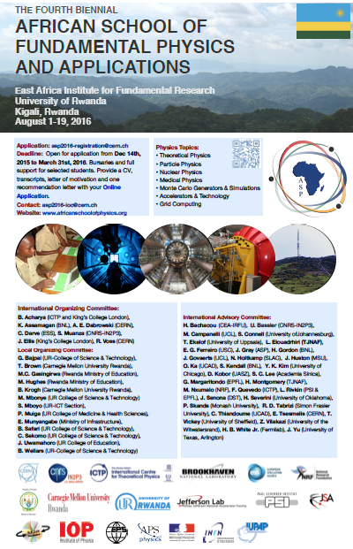
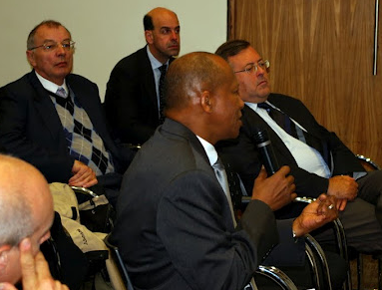
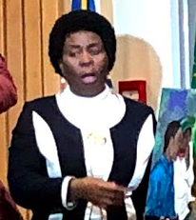
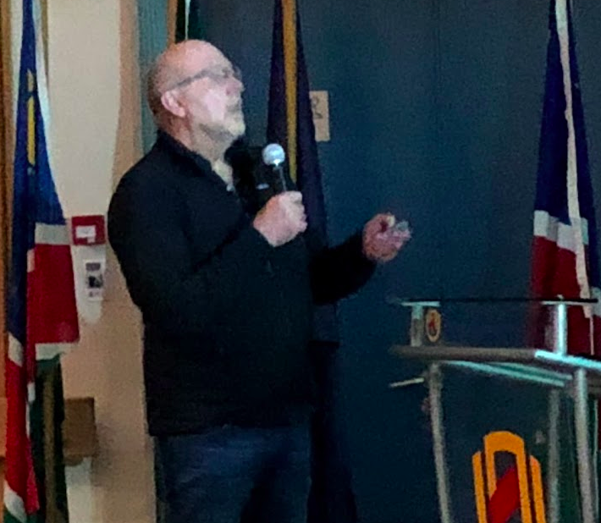
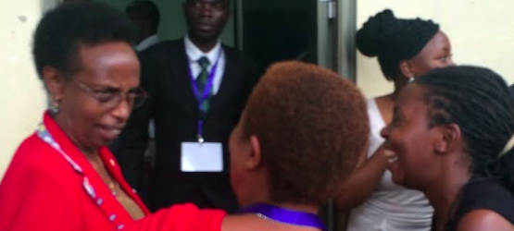
UN support
Dr. H. TOURE, UN ITU Secretary General.
Prof. A. WAGUE and O. KA
M. NGOM - US Embassy rep.
Forum and Outreach Day
AfLS and compact acc.
Prof. H. WINICK, Prof. Emeritus, SLAC and Prof. L. SERAFINI (INFN, IT)
Dedicated to Knowledge and Transfer of Technology
Dr. D. ADAMS, chief director: Emerging Research areas & Infrastructure, Human Capital and Knowledge Systems.
East Afr. Science and New ICTP Center
Rwandan Ministry of Education
Dr T. TJIVIKUA, Vice-Chancellor, Namibia University of Science and Technology (Namibia)
Dr. R. ADAM (SKA, SA)
Notes:
Sharing ideas oriented towards building international collaborations and developing innovative technology in partnership with universities, national laboratories, the government and industry.
In 2010, immovation and technology transfer.
In 2012: compact accelerator, and Af LS as a conceptual idea
In 2014: Dr TOURE as a role model for science. His activity as head of the ITU, promoted widely ICT in Affrica. ”Many observers say he helped change the face of ICTs in the Third World.” He joined for one day forum, despide the breaking news of the Ebola crisis emerging in Senegal !!
In 2016: Political situations and visit of Rwandan ministry of education. The role of women has been emphasized.
In ASP2018, The forum day consisted of lively discussions and debate about education and capacity building in Namibia and Africa in general.
----------
Several high-profile South African scientists and government officials participated in the last day of the school. This outreach and forum day reviewed the practical aspects of fundamental physics, which could be used as a gateway to innovation and to enhance future collaborations.
The Forum Day, however, has a much wider appeal. It takes advantage of opportunity provided by the key visiting experts who would like to connect with experts in Government, Industry and Research. It is planned and delivered by a selection of the world’s top educators and practitioners of High Energy Physics, Research and also Applications.

Slide 15
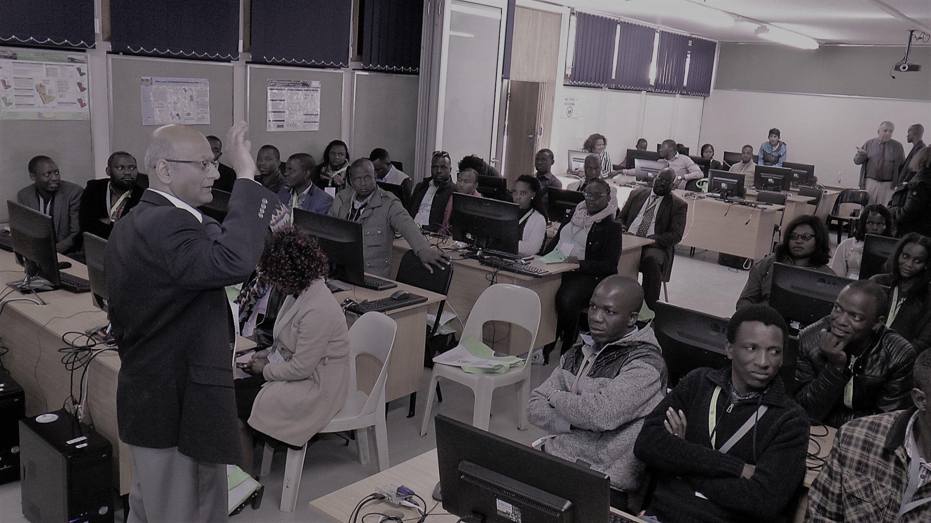
High School Teachers
Objective:
Support teacher growth in the planning and delivering of instructions
Teachers program is running in parallel to the students program
For the ASP2018, 63 teachers, from the 14 regions of Namibia, identified by the Local Organizing Committee and the Ministry of Education, Arts & Culture
Program designed such that the teacher could attend the ASP conference – Physics Education and Physics Communication Tracks in particular
Notes:
Snapshot - Show how to build a cloud chamber, use of raspberry pi in practical sessions.
Demonstrations of the usage of cloud chambers as a simple example of particle detectors
were carried out for students, teachers and high school learners. The high school teachers were introduced to mathematical teaching tools based on the Raspberry Pi. Particle physics masterclasses were organized for students and high school teachers.
The teachers also attended the Physics Education and Physics Communication sessions of the ASP conference, and one of the teachers served on a panel for discussions on science education and capacity development in Africa.
Use of digital platform could be a solution to increase science teaching, teachers and students could channel the information: combine ICT and learning

Slide 16
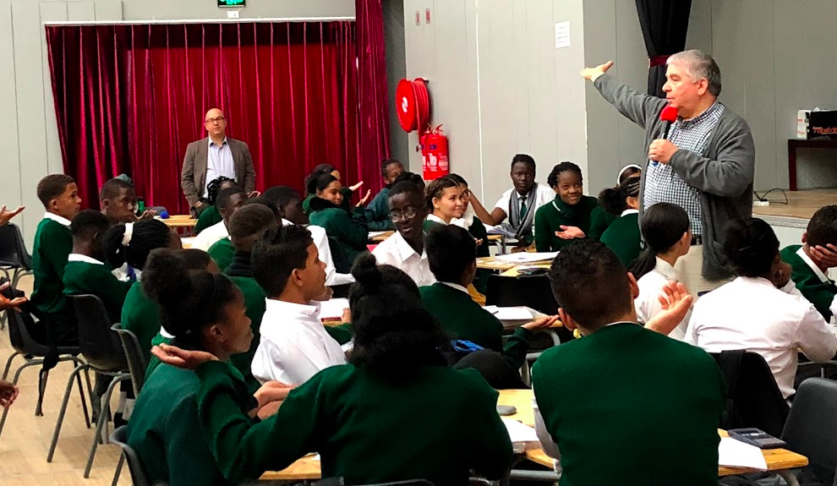
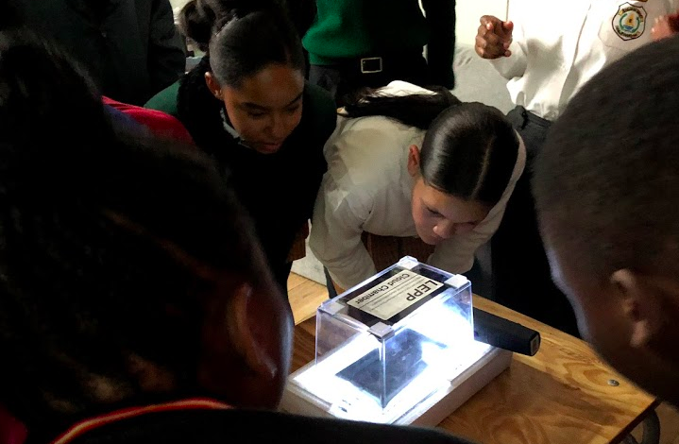
High School Learners
10-12th grade learners
The objective is to motivate pupils to develop or maintain interest in physics and related disciplines.
Notes:
In Windhoek, up to 1500 pupils !,
by gathering HS into 4 locations, more effective to spread and foster science in Africa…
Show cloud chamber experiment.
The excitement of the high-school students were communicative.
At the end of the session, every pupils responded that they wanted to pursue with science !

Slide 17
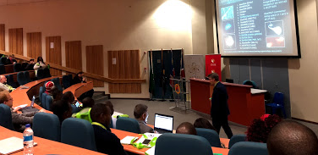
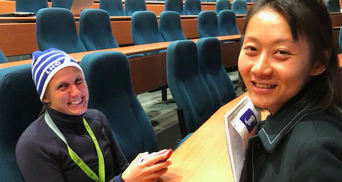
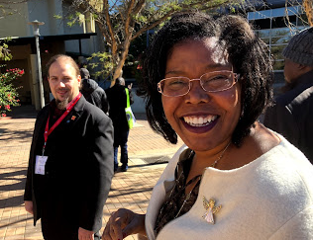
ASP Conference
Participation of ASP Alumni
The proceedings of the ASP conference are in preparation to be published as a special issue of the African Review of Physics.
Participation of Research Faculties
Networking and collaborations
Professional presenting key-African-projects
Debate on the high education development in Namibia and South-Africa
Notes:
in parallel to the student program.
The teachers also attended the Physics Education and Physics Communication sessions of the ASP conference, and one of the teachers served on a panel for discussions on science education and capacity development in Africa.
ASP2018, The Namibia Deputy Minister of High Education, Training and innovation (HETI) gave the guest of honor address during the opening session of the conference.
The proceedings of the ASP conference are in preparation to be published as a special issue of the African Review of Physics.

Slide 18
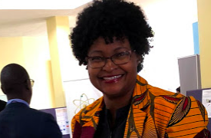
Mentorship and Coaching
Summary Purpose Strengths & Needs for Improvement
ASP2016: 20 students
ASP2018: 36 students registered
Track the impact of ASP
Support students & help address their academic needs
Work with Academic advisor
Formation of collaborations
Get African students involved
Connect Students w/ researcher
Improve the ASP program
Enthusiastic Mentors
Ability to share support beyond the academic level
Increasing # of Mentors & Mentees
Expert pairing
Capacity building
Funding & Partnerships
Notes:
In 2010 – Fermilab Fellowship, Neutrino Physics.
Since ASP2016, This is done in collaboration with the academic advisers of the students.
The student alumni are paired up different ASP lecturers whose roles are to follow the academic progress of the students and help as much as possible in the academic development of the students.
The objective of the mentorship program is to aid mainly PhD students after their participation in ASP to reach their goal of completing their PhD with assigned ASP lecturers as mentors. The ASP mentors are not replacements or substitutes of the students academics advisers. Rather, ASP mentors work together with students academic advisers for greater impact.
The ASP mentors are volunteers physicists that have lectured at one of the previous editions of ASP.

Slide 19
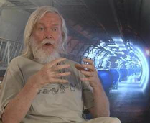
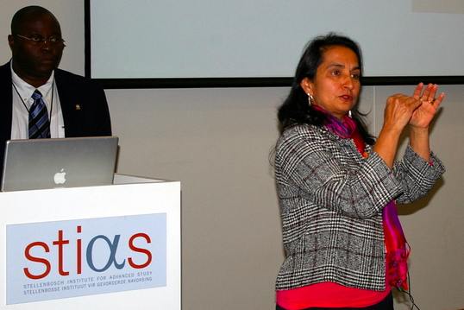
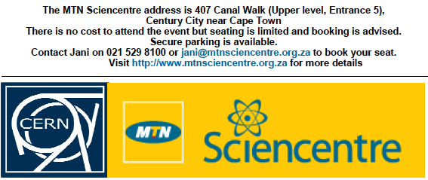
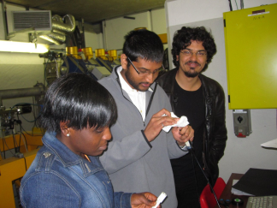
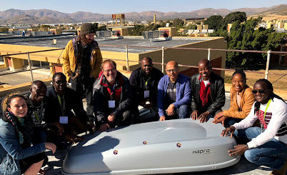
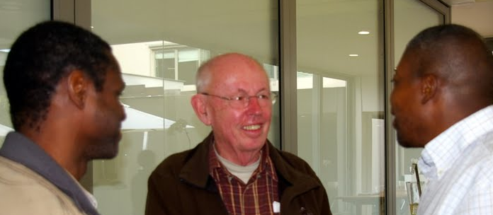
Beyond the Academics
Social activities to facilitate interactions among students and lecturers
Create network for student: email, blog, web, FB, WhatsApp
Provide student with materials: indico, booklets
Video connection to CERN CCC and ICHEP conf.
Share experience with public lectures
Produce movie and press release
Students poster & oral sessions
Hands-on and lab-work
Shipping equipment (cloud chamber, PC, BPM)
Student Survey and School reports
Notes:
Students became acquainted with the use of scintillation detectors and performed measurements of environmental radioactivity
Providing equipment for hands- on exercise, using BPM, cloud chamber

Slide 20
Where do African alumni go?
North America
Asia
7%
3%
African Alumni
89 complete records
58% stayed in-country
10%
21%
Courtesy Julia Gray
Europe
Other Africa
Notes:
Based on the 2018 survey of 100 Alumni students.

Slide 21
Current studies and employment
“What do you do now? (you can make multiple selections) “
Studies and employment | # of alumni
Full time undergraduate student | 2
Part time undergraduate student | 0
Full time masters student | 19
Part time master student | 1
Full time doctorate student | 39
Part time doctorate student | 4
Studying at a non-degree granting institution | 1
Full time postdoctoral researcher | 3
Part time postdoctoral researcher | 2
Full time professional work | 11
Part time professional work | 3
Full time work | 3
Part time work | 10
Internship | 5
Unemployed | 4
Looking for higher education opportunities | 26
Part time
26
Looking for
Education
Opportunities
Full time
Courtesy Julia Gray
Notes:
1/5 of the students need to combine more than one activity (e.g. working and progressing with their study).

Slide 22
Movements of African alumni in Africa
Algeria
1
Egypt
1
Senegal
1
Ethiopia
1
Niger
1
Ethiopia
2
Nigeria
2
Togo
2
Rwanda
6
Cameroon
2
Cameroon
1
Kenya
1
Rwanda
4
Where did they leave?
Where did they go?
Tanzania
1
Botswana
1
Namibia
5
Namibia
1
Madagascar
1
Courtesy Julia Gray
South Africa
4
Notes:
Depend on institute: AIMS, ICTP, etc..
Bias survey : country of residency (study, so possible transient), not origin ..
24 African countries with survey responses. 8 countries with record of Alumni students leaving,

Slide 23
And finally some relaxing time: Excursions and Festivities

Slide 24
Science can transcend boundaries thanks to the ASP Program by giving exposure to African talents to Fundamental Physics and Applications
Our mission is also beyond academics !
We thanks our sponsors, the dedication of our lecturers, the perseverance of our students
Get Involved with ASP !

